Slide 1









M a n u f a c t u r I n g R F Q M a n a g e m e n t

Slide 2
O U R T E A M
J H e m a n t h K u m a r a S w a m y
( 2 0 6 6 1 4 1 )
F a r h a n k h a n S o u d a g a r
( 2 0 6 6 1 3 4 )
U r v a s h i K a n d e k a r
( 2 0 6 6 0 2 1)
K e e r t h a n a S r i p a d a
( 2 0 6 6 0 4 7 )
2

Slide 3





RFQ MANAGEMENT I N A SHELL
Supplier Microservice
Fabricate Portal
Authentication microservice
Plant
Microservice
Admin
(medium)
RFQ
Microservice
3

Slide 4








R E Q U I R E M E N T A N A L Y S I S

Slide 5
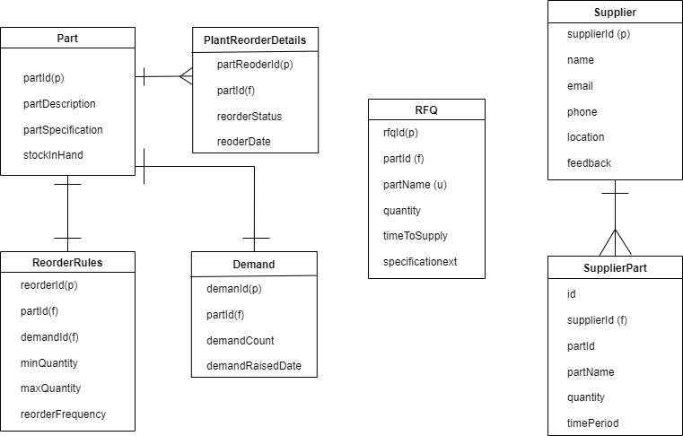
C L AS S D I AG R A M

Slide 6





D E V E L O P M ENT & D E S I G N I N G
6

Slide 7







M I C R O S E R V I C E S
JWTAuth Microservice - to handle authentication of the Supplier
Supplier microservice - to handle supplier related services
Plant microservice - to handle stock replenishment of plant
RFQ microservice - to get the RFQ details from plant and supplier
7

Slide 8
A U T H OR I Z A T I O N M I C R O S E R V I C E

Slide 9







REST E N D P O I N T S
/login - to log in the employee and generate jwt token
/validate - to validate the jwt token
11

Slide 10
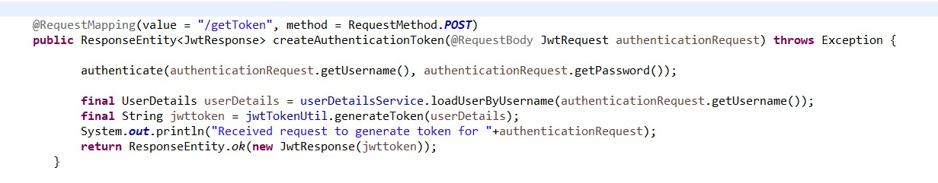
R e s t C o n t r o l l e r
One of the Post mappings of the rest controller (to login the user)
Rest controller calls the
UserDetailsService.java where all the necessary details are implemented

Slide 11
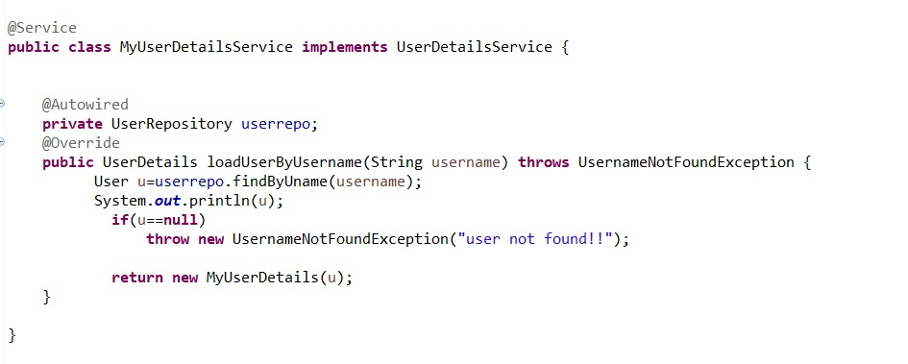
A U T H S E RVI C E

Slide 12

S U P PL I E R M I C R O S E R V I C E

Slide 13
R E S T E N D P O I N T S
Supplier/getAllSupplier - to view supplier details
/supplier/getSupplierOfPart/{part_id} - to view supplier details by part id parameter
/supplier/addSupplier - to post the new supplier
/supplier/editSupplier - to edit the supplier details
/supplier/updateFeedback - to update the feedback
16

Slide 14
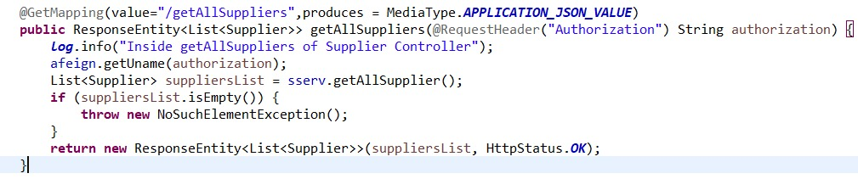
R E S T C o n t r o l l e r
One of the Get mappings of the rest controller (to view the list of the supplier)
Rest controller calls the supplierService.java where all the necessary details are implemented

Slide 15
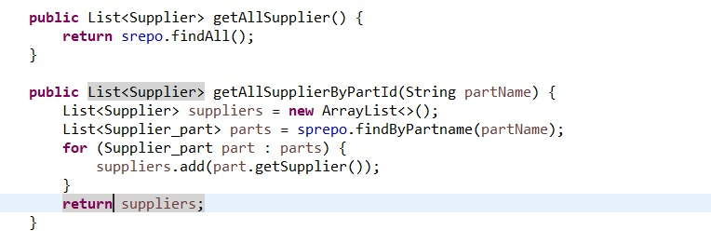
SUPPLIER S E RVI C E

Slide 16
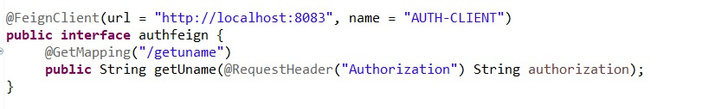
F E I G N C L I E N T
Auth client - to communicate with the authentication microservice
20

Slide 17
P L A N T M I C R O S E R V I C E

Slide 18
R E S T E N D P O I N T S
/plant/viewPartsReOrder - to view parts that needs to be reorder
/plant/viewStockInHand/{part_id} - to view stock details
/plant/updateMinMaxQuantities/{part_id}/{min}/{max} - to post updated min ,max count
22

Slide 19
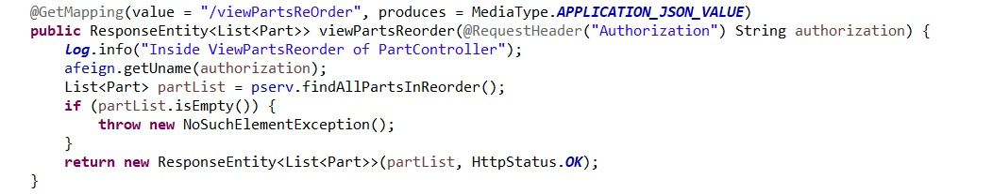
R E S T C o n t r o l l e r
One of the Get mappings of the rest controller (to get the details of parts)
Rest controller calls the plantService.java where all the necessary details are implemented

Slide 20
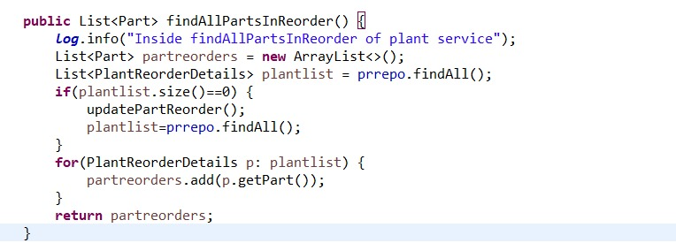
P L A NT S E R VI C E

Slide 21
F E I G N C L I E N T
Auth client - to communicate with the authentication microservice
26

Slide 22

R F Q M I C R O S E R V I C E

Slide 23
R E S T E N D P O I N T S
rfq/getRFQOfPlant/{part_id} - to get the RFQ details of parts based on part id
rfq/getPotentialVendorsOfRFQ/{rfq_id} - to get the list of vendors who has the feedback rating above 7
28

Slide 24
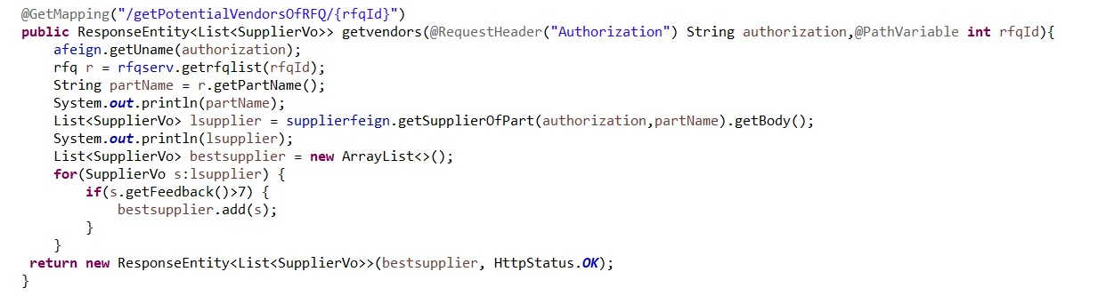
R E S T C o n t r o l l e r
One of the Get mappings of the rest controller (to get the list of potential vendors)
Rest controller calls the rfqService.java where all the necessary details are implemented

Slide 25
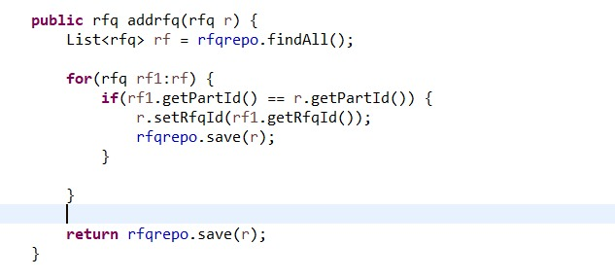
R F Q S E R VI C E

Slide 26
F E I G N C L I E N T
Auth client - to communicate with the authentication microservice
20

Slide 27
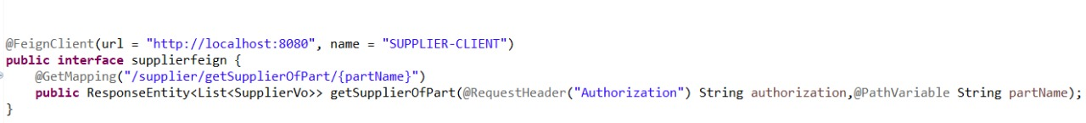
F E I G N C L I E N T
Supplier client - to communicate with the Supplier microservice
26

Slide 28
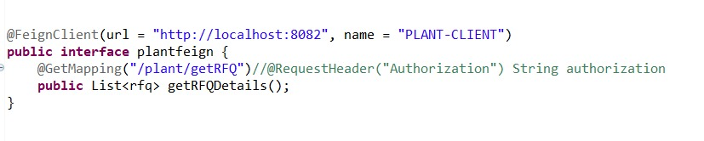
F E I G N C L I E N T
Plant client - to communicate with the Plant microservice
26

Slide 29
TEST I N G

Slide 30
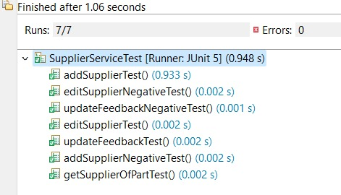
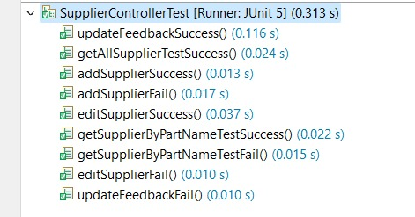
SUPPLIER ​MICROSERVICE​

Slide 31
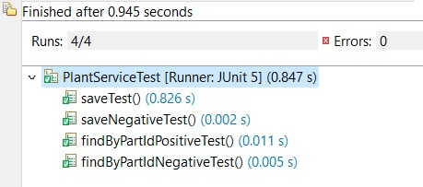
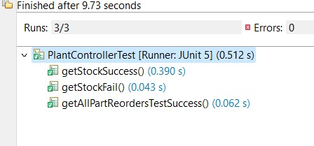
PLANT MICROSERVICE​

Slide 32
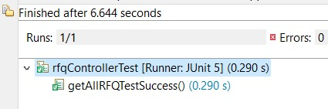
RFQ MICROSERVICE​

Slide 33
U S E R I N T E R F ACE

Slide 34
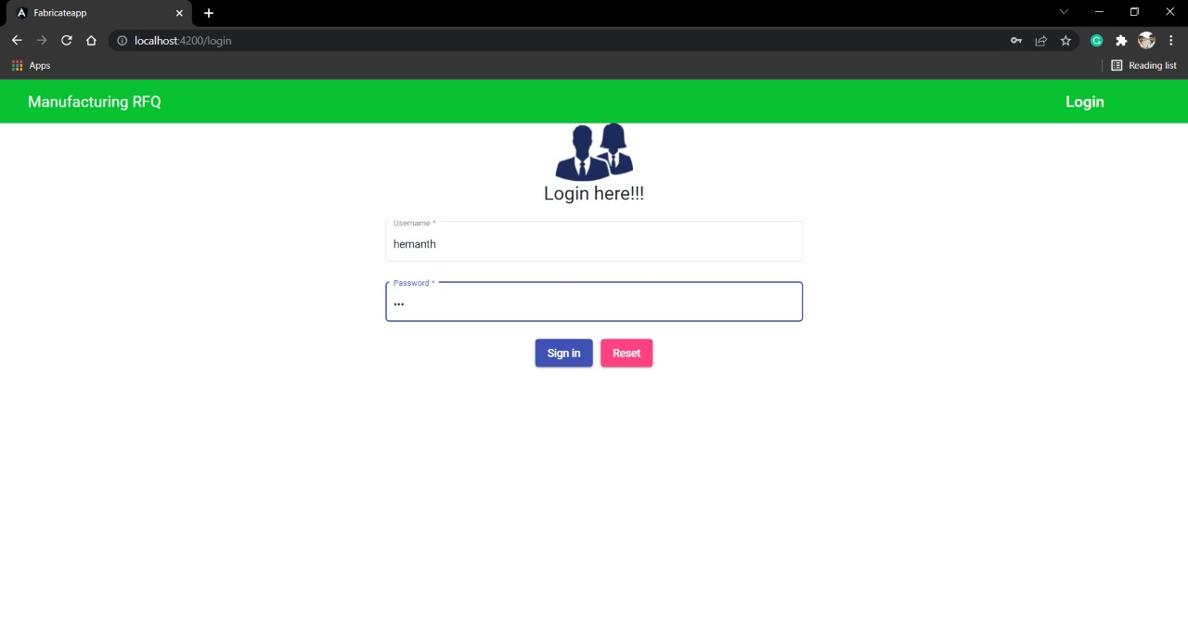
LOGIN PAGE

Slide 35
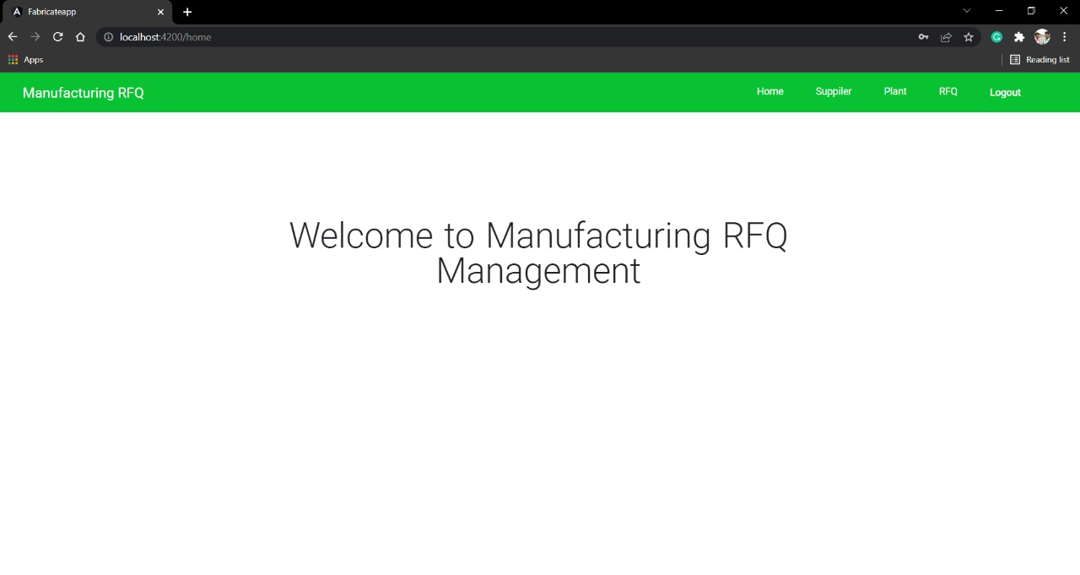
MAIN PAGE

Slide 36
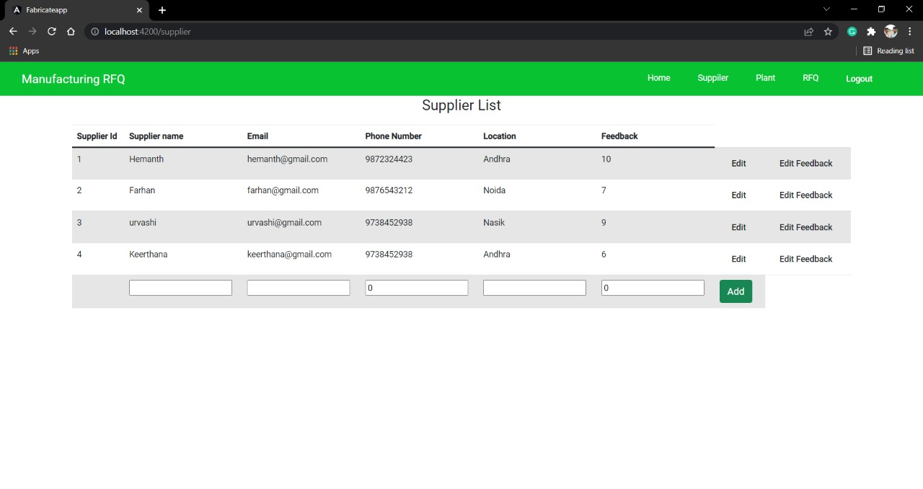
SUPPLIER PAGE

Slide 37
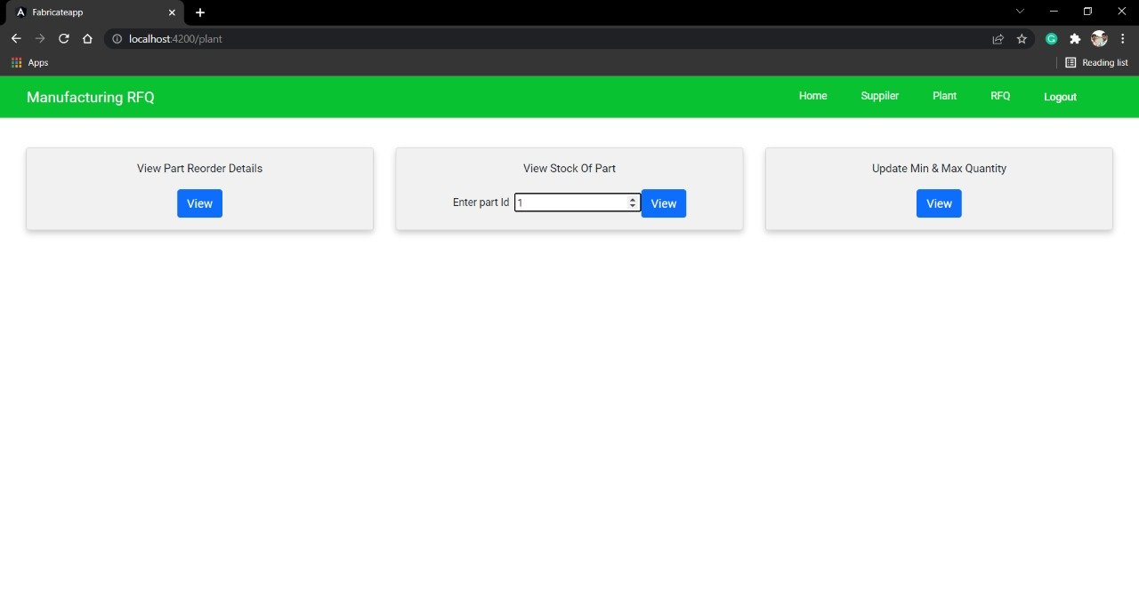
PLANT MODULE

Slide 38
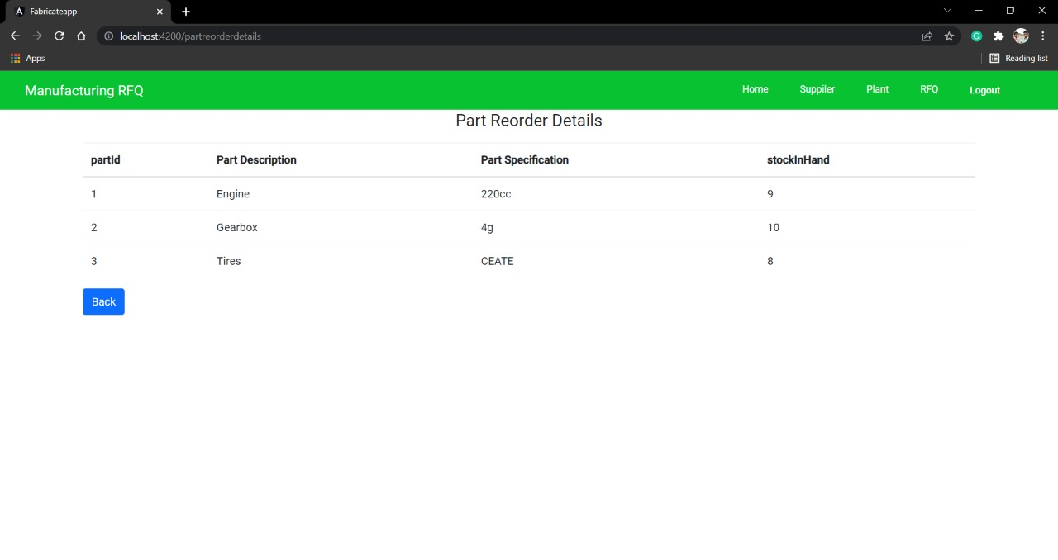
PART REODER DETAILS PAGE

Slide 39
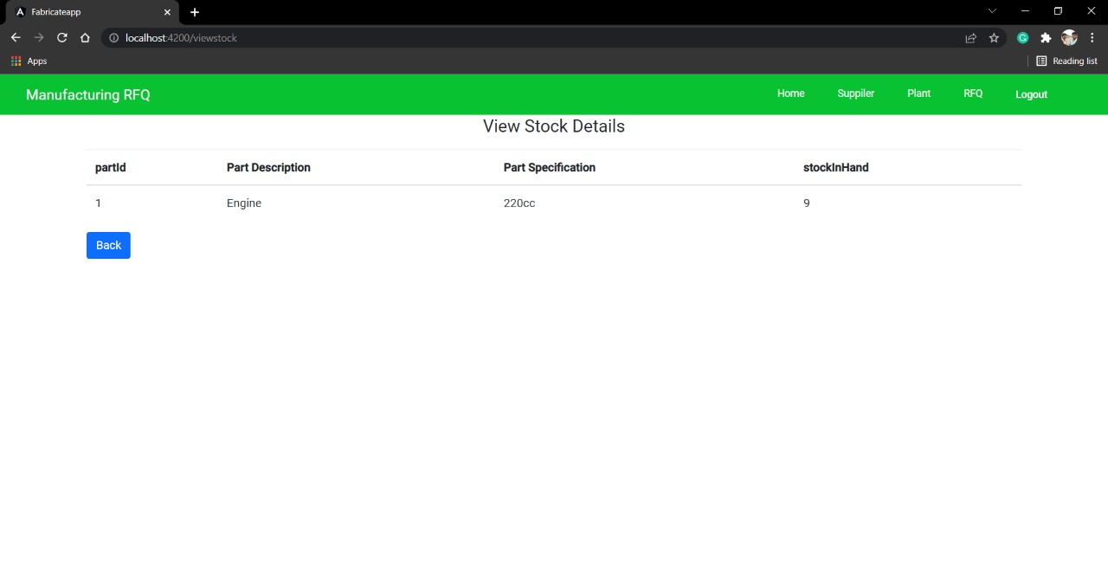
VIEW STOCK PAGE

Slide 40
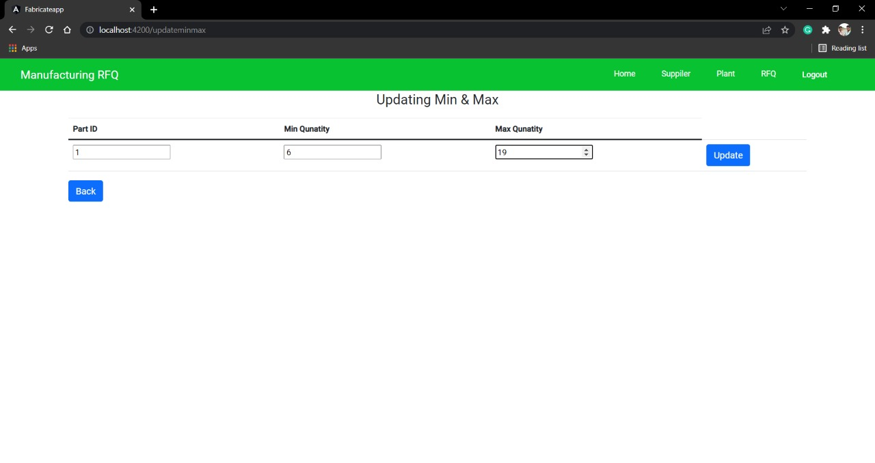
UPDATE QUANTITIES PAGE

Slide 41
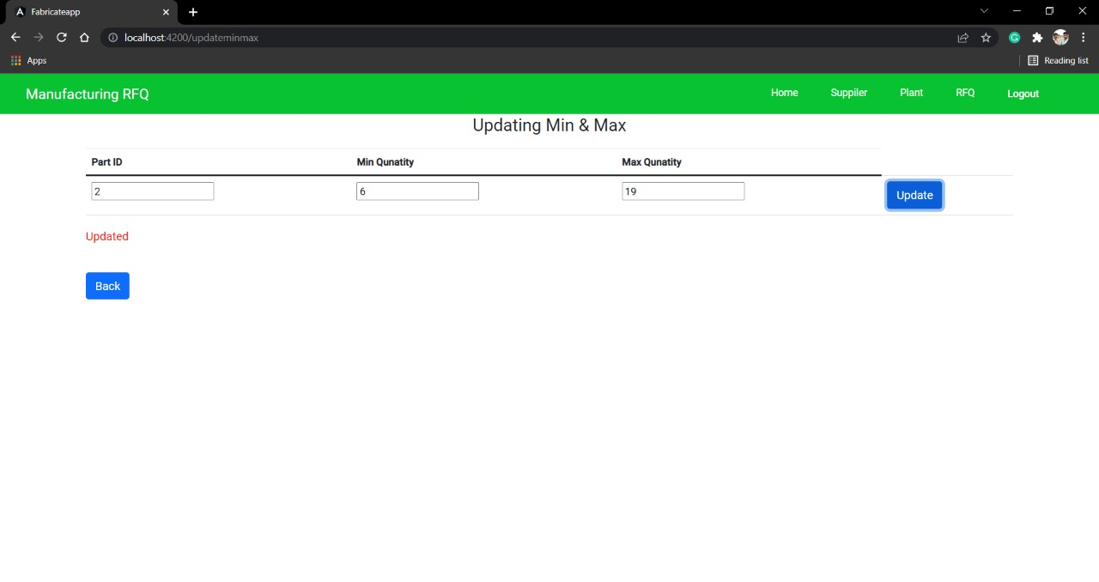

Slide 42
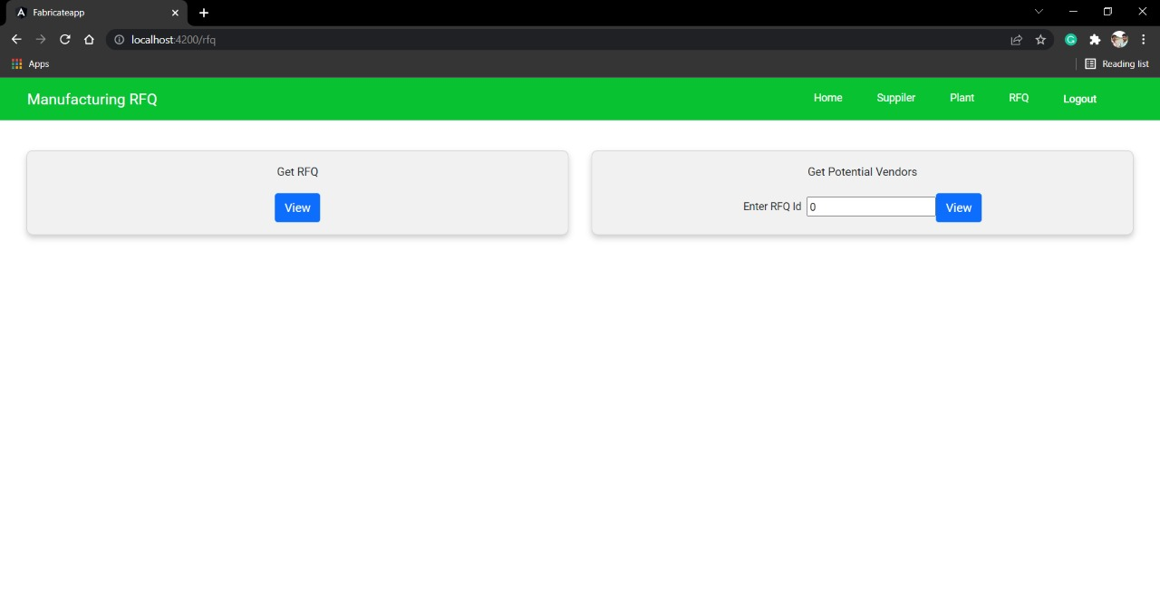
RFQ MODULE

Slide 43
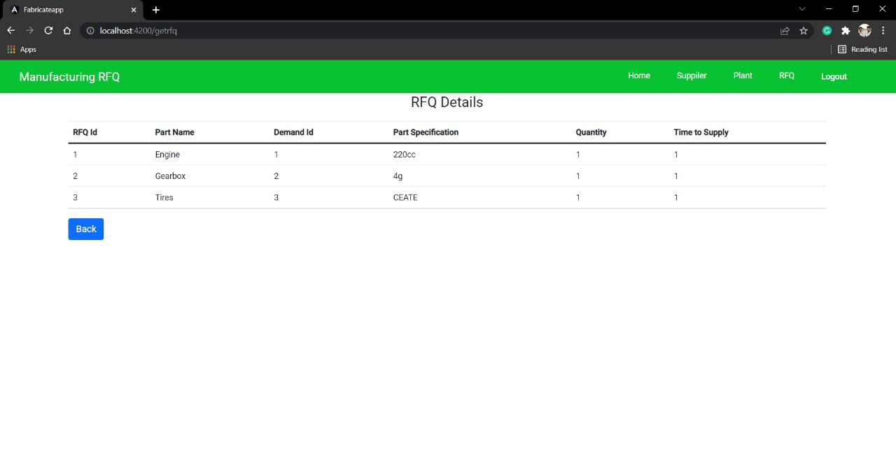
RFQ DETAILS PAGE

Slide 44
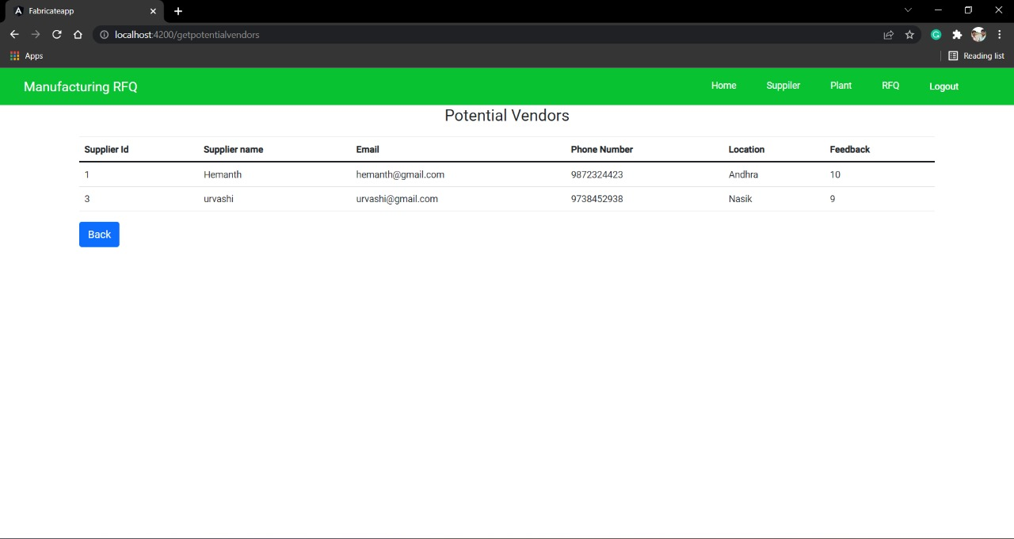
POTENTIAL VENDORS PAGE

Slide 45
D E P L OY M E N T
48

Slide 46
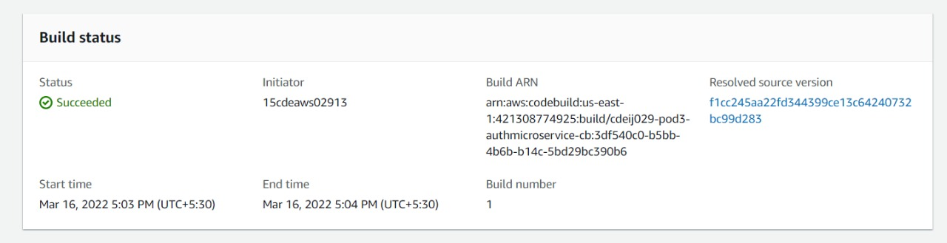
A U T H O R I Z A T I O N M I C R O S E R V I C E
Build Stage
Deploy Stage

Slide 47
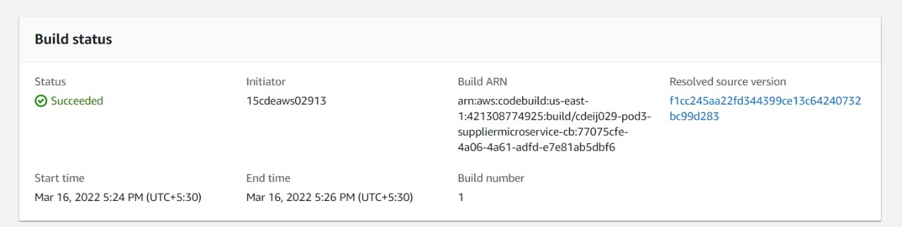
S U P PL I E R M I C R O S E R V I C E
Build Stage
Deploy Stage

Slide 48
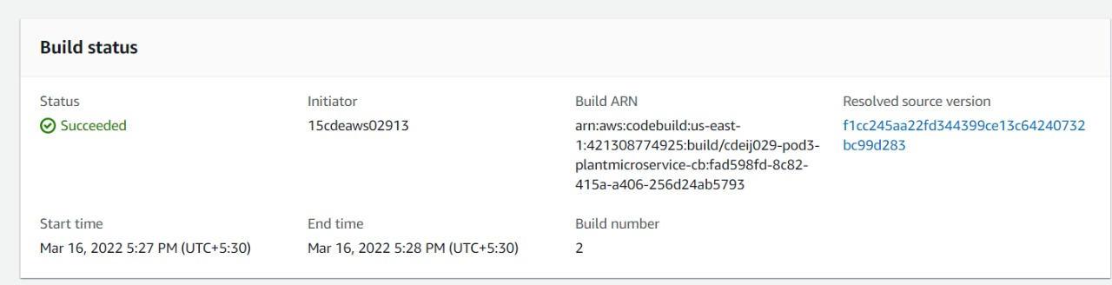
P L A N T M I C R O S E R V I C E
Build Stage
Deploy Stage

Slide 49
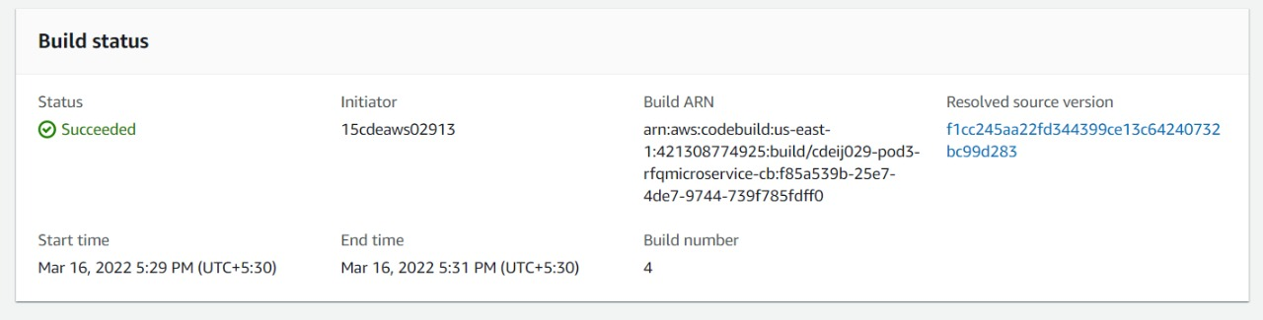
R F Q M I C R O S E R V I C E
Build Stage
Deploy Stage

Slide 50









T H A N K Y O U

